Slide 1
Used Cars Quality Evaluation System

Slide 2
Contents
Introduction
Evolution
Proposed System
Software Requirement Analysis
Data Flow Diagram
Implementation
Testing
Conclusion

Slide 3
Introduction
Many people get scammed while buying a used car over the quality of the car they are buying.
The quality evaluation system helps one in confirming whether the car they are buying is worth it or not.

Slide 4
Evolution
This project is helpful in people getting scammed by giving them an accurate analysis on whether the quality of the car is acceptable or not.

Slide 5
Proposed System
This system will detect the car, run it through its system and give us an analysis on whether the car acceptable or not .
This system will be very useful to prevent scams by alerting the buyer on whether it’s a good deal or not.

Slide 6
Software Requirement Analysis
FUNCTIONAL REQUIREMENTS:
It must show the detect the car.
It must give an analysis on whether the car is not-acceptable, acceptable, good or very good.
NON FUNCTIONAL REQUIREMENTS:
User friendly.

Slide 7
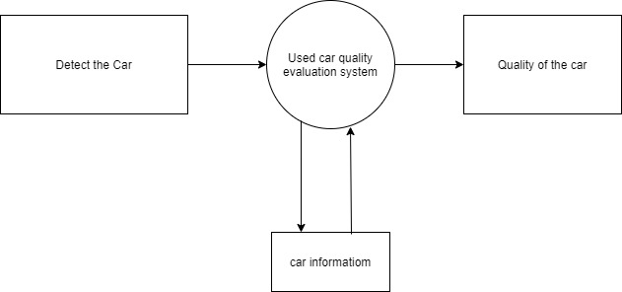
Data Flow Diagram

Slide 8
Implementation
Detecting faces:
Detect the information of the car inserted.
Analyse the car:
Analyse the car’s information.
Check quality:
Checked the quality of the car.
Collect data:
Collect the status of the car from above.
Plot graph:
Plot graph according to the information stored(quality of the car).

Slide 9
Testing
Software testing is very important in every module. Before deploying a software it is tested among various tests in order to understand mistakes, if any, beforehand.
Testing is the last thing where a developer is confirmed to deploy the particular product which ensures the quality of the software and comfortable for the users to use.

Slide 10
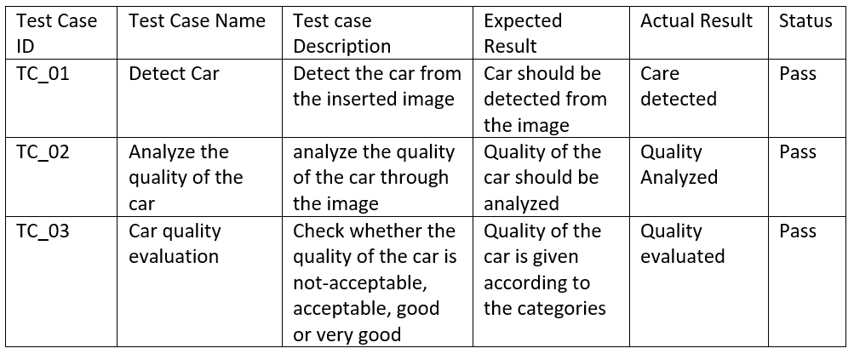
Test Cases

Slide 11
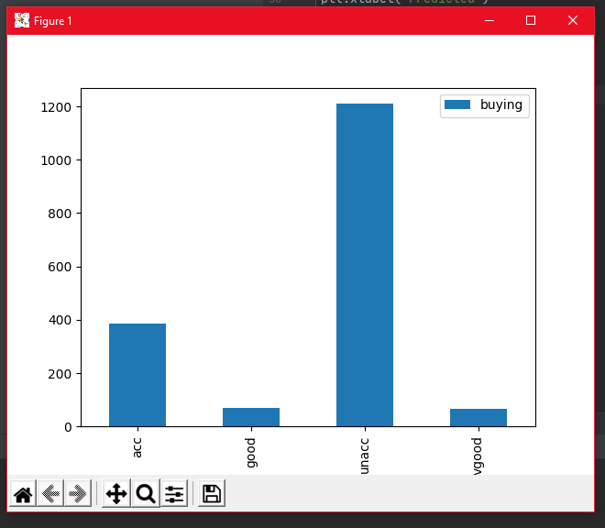
System Visuals

Slide 12
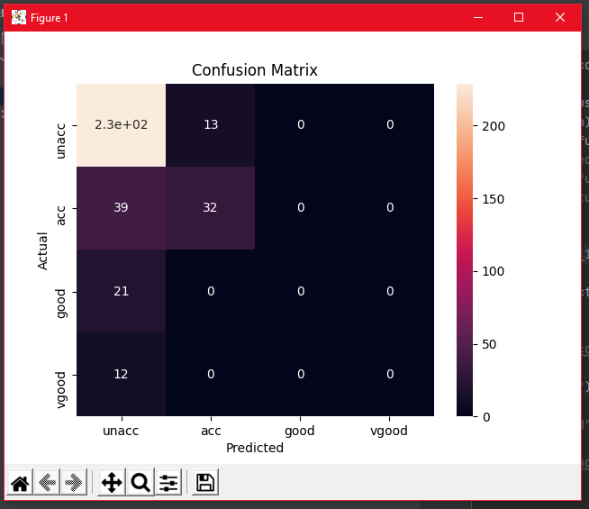

Slide 13
Conclusion
In this Python project, we have built a system in order to prevent scams by sending analysis on quality of the cars and can be implemented in numerous ways. We used sklearn to detect the quality of the car and matplotlib and pandas to represent the analysis.

